Slide 1
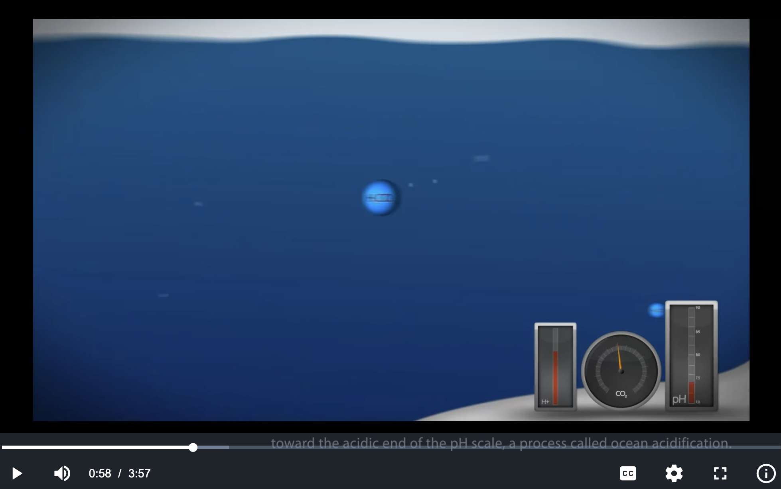
Impacts of ocean acidification
https://en.wikipedia.org/wiki/Ocean_acidification

Slide 2
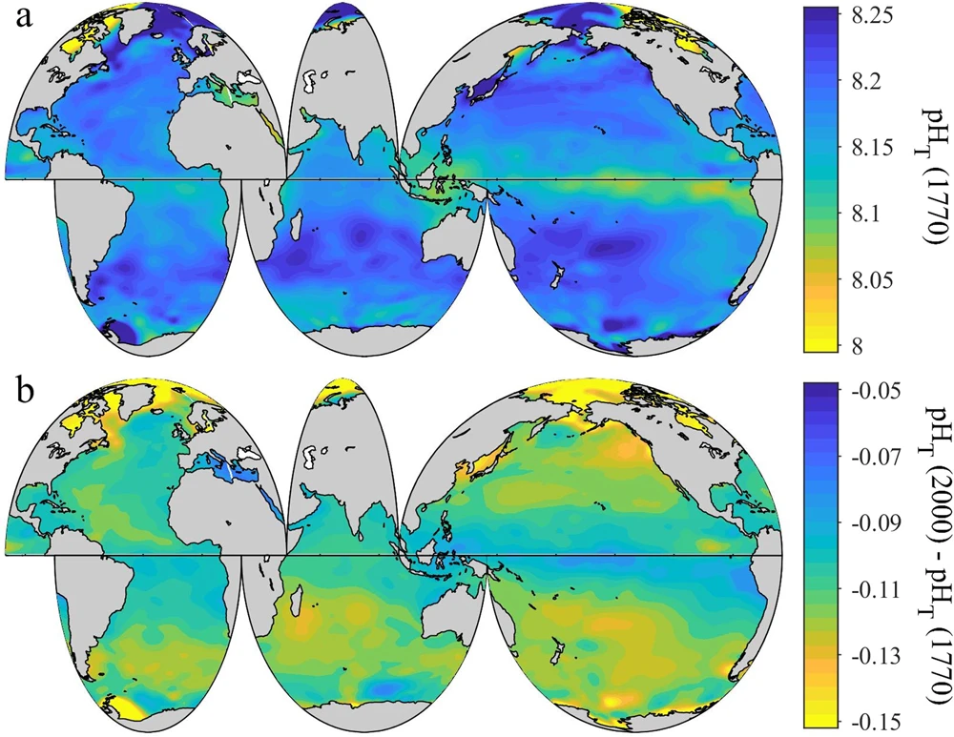
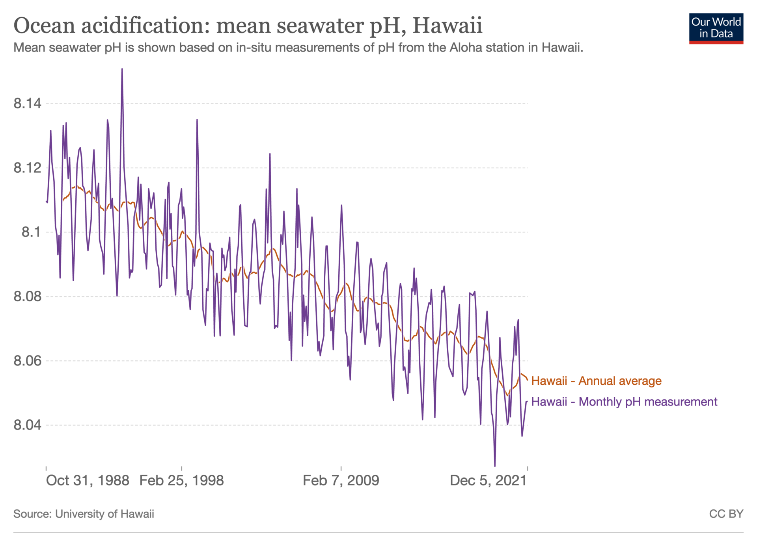
Trends in ocean acidification

Slide 3

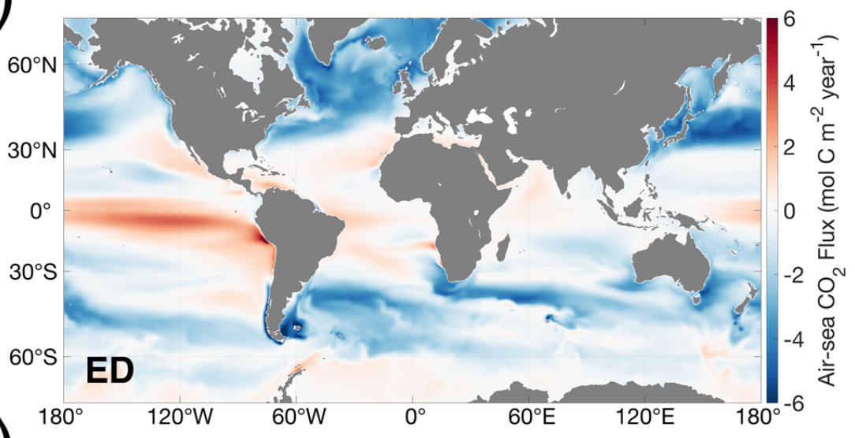
Where are the sources? sinks?
Red => The ocean is a source of CO₂ to the atmosphere
Blue => Atmospheric CO₂ sink
Carroll et al, 2020 https://agupubs.onlinelibrary.wiley.com/doi/epdf/10.1029/2019MS001888

Slide 4

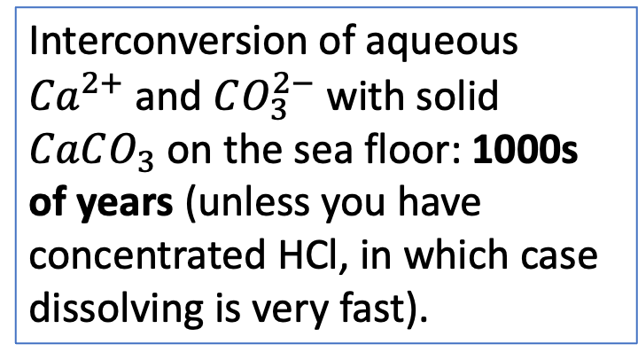

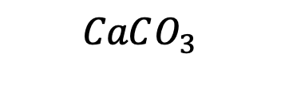








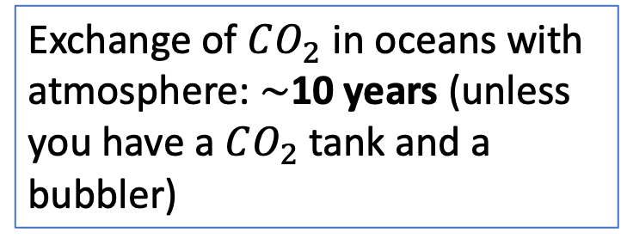
Time scales of these reactions
Exchange of $CO_{2}$ in oceans with atmosphere: $\sim$10 years (unless you have a $CO_{2}$tank and a bubbler)
Air
$$CO_{2}$$
$$H_{2}O$$
$$H_{2}O$$
Oceans
$H_{2}CO_{3}$
$$H^{+}$$
$$H^{+}$$
Ocean acid-base chemistry: minutes
$$HCO_{3}^{−}$$
$${Ca}^{2+}$$
Interconversion of aqueous ${Ca}^{2+}$ and $CO_{3}^{2−}$ with solid $CaCO_{3}$ on the sea floor: 1000s of years (unless you have concentrated HCl, in which case dissolving is very fast).
$$CO_{3}^{2−}$$
Sea floor
$$CaCO_{3}$$
$$CaCO_{3}^{}$$

